Slide 1
Disclaimer
All the topics followed in this lecture are from Principles of microeconomics, by N. G. Mankiw 4th Edition, which is being used as a one of the standard textbook for this course. The data taken from the book is entirely for study purposes and no copyright infringement is intended.

Slide 2
C o n s u m e r s , p r o d u c e r s , a n d t h e e f f i c i e n c y o f m a r k e t s
Chapter 7

Slide 3
REVISITING THE MARKET EQUILIBRIUM
Do the equilibrium price and quantity maximize the total welfare of buyers and sellers?
Market equilibrium reflects the way markets allocate scarce resources.
Whether the market allocation is desirable can be addressed by welfare economics.

Slide 4
Welfare Economics
Welfare economics is the study of how the allocation of resources affects economic well-being.
Buyers and sellers receive benefits from taking part in the market.
The equilibrium in a market maximizes the total welfare of buyers and sellers.

Slide 5
Welfare Economics
Equilibrium in the market results in maximum benefits, and therefore maximum total welfare for both the consumers and the producers of the product.

Slide 6
Welfare Economics
Consumer surplus measures economic welfare from the buyer’s side.
Producer surplus measures economic welfare from the seller’s side.

Slide 7
CONSUMER SURPLUS
Willingness to pay is the maximum amount that a buyer will pay for a good.
It measures how much the buyer values the good or service.

Slide 8

CONSUMER SURPLUS
Consumer surplus is the buyer’s willingness to pay for a good minus the amount the buyer actually pays for it.

Slide 9

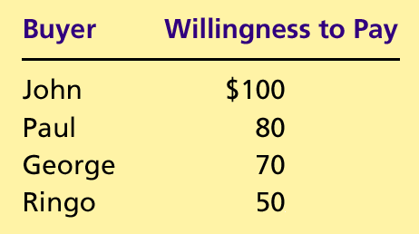
Table 1 Four Possible Buyers’ Willingness to Pay
Copyright©2004 South-Western

Slide 10
CONSUMER SURPLUS
The market demand curve depicts the various quantities that buyers would be willing and able to purchase at different prices.

Slide 11
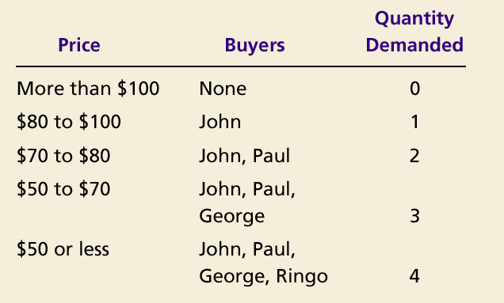
The Demand Schedule and the Demand Curve

Slide 12

Figure 1 The Demand Schedule and the Demand Curve
Price of
Album
$100
John
’
s willingness to pay
80
Paul
’
s willingness to pay
70
George
’
s willingness to pay
50
Ringo
’
s willingness to pay
Demand
0
1
2
3
4
Quantity of
Albums
Copyright©2003 Southwestern/Thomson Learning

Slide 13
Figure 2 Measuring Consumer Surplus with the Demand Curve
(a) Price = $80
Price of
Album
$100
John
’
s consumer surplus ($20)
80
70
50
Demand
0
1
2
3
4
Quantity of
Albums
Copyright©2003 Southwestern/Thomson Learning

Slide 14
Figure 2 Measuring Consumer Surplus with the Demand Curve
(b) Price = $70
Price of
Album
$100
John
’
s consumer surplus ($30)
80
Paul
’
s consumer
70
surplus ($10)
Total
50
consumer
surplus ($40)
Demand
0
1
2
3
4
Quantity of
Albums
Copyright©2003 Southwestern/Thomson Learning

Slide 15
Using the Demand Curve to Measure Consumer Surplus
The area below the demand curve and above the price measures the consumer surplus in the market.

Slide 16
Figure 3 How the Price Affects Consumer Surplus
(a) Consumer Surplus at Price
P
Price
A
Consumer
surplus
P₁
B
C
Demand
0
Q₁
Quantity
Copyright©2003 Southwestern/Thomson Learning

Slide 17
Figure 3 How the Price Affects Consumer Surplus
(b) Consumer Surplus at Price
P
Price
A
Initial
consumer
surplus
P₁
C
Consumer surplus
B
to new consumers
P₂
F
D
E
Additional consumer
Demand
surplus to initial
consumers
0
Q₁
Q₂
Quantity
Copyright©2003 Southwestern/Thomson Learning

Slide 18
What Does Consumer Surplus Measure?
Consumer surplus, the amount that buyers are willing to pay for a good minus the amount they actually pay for it, measures the benefit that buyers receive from a good as the buyers themselves perceive it.

Slide 19
PRODUCER SURPLUS
Producer surplus is the amount a seller is paid for a good minus the seller’s cost.
It measures the benefit to sellers participating in a market.

Slide 20
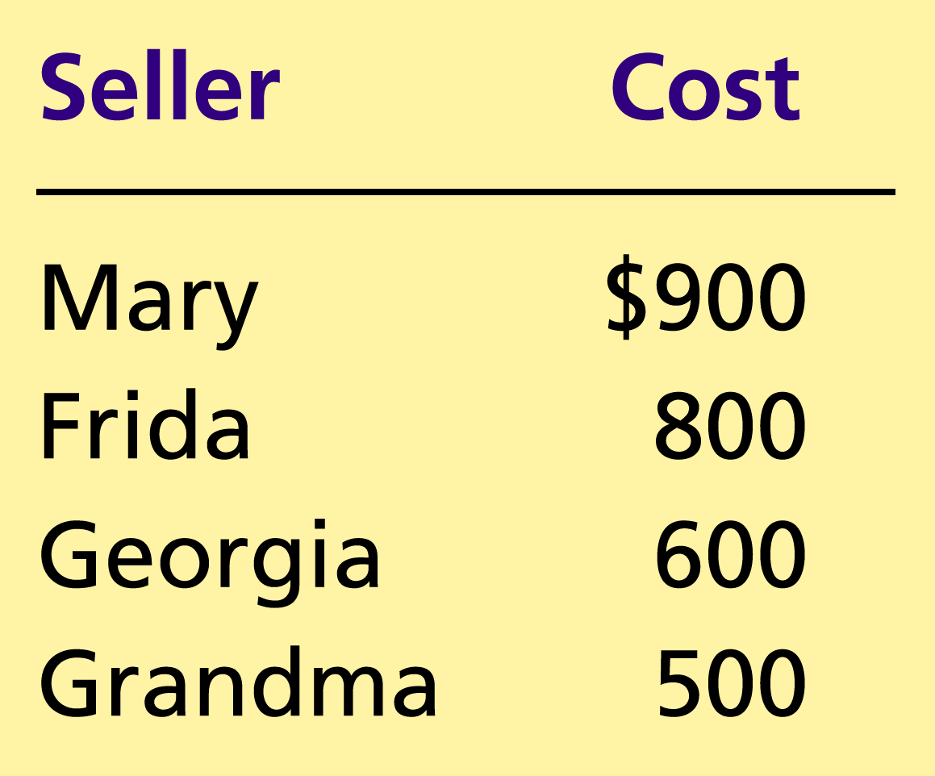
Table 2 The Costs of Four Possible Sellers
Copyright©2004 South-Western

Slide 21
Using the Supply Curve to Measure Producer Surplus
Just as consumer surplus is related to the demand curve, producer surplus is closely related to the supply curve.

Slide 22
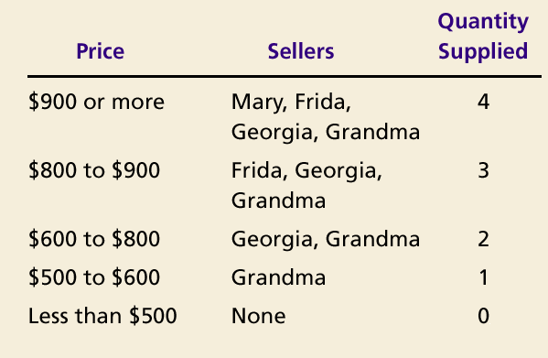
The Supply Schedule and the Supply Curve

Slide 23
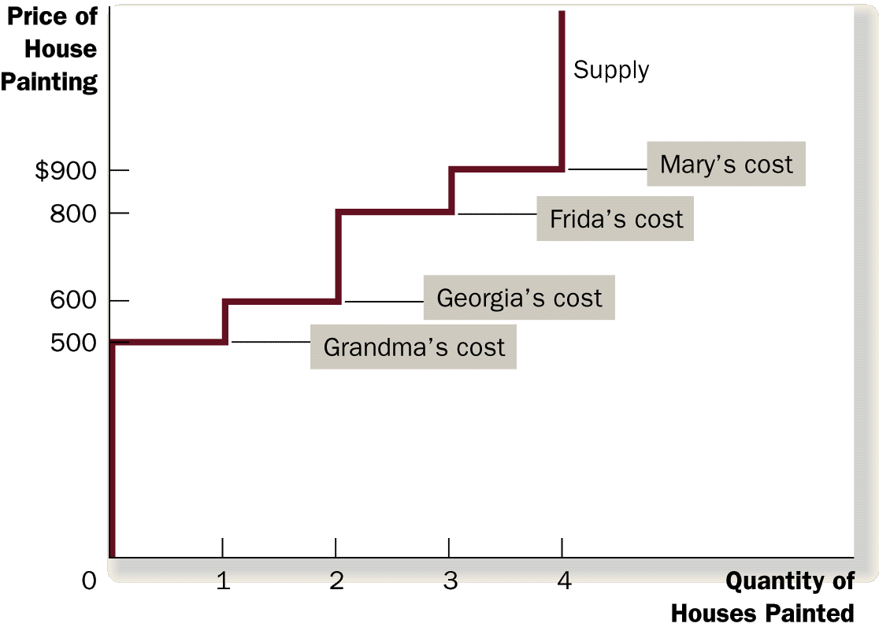
Figure 3 The Supply Schedule and the Supply Curve

Slide 24
Using the Supply Curve to Measure Producer Surplus
The area below the price and above the supply curve measures the producer surplus in a market.

Slide 25
Figure 4 Measuring Producer Surplus with the Supply Curve
(a) Price = $600
Price of
House
Painting
Supply
$900
800
600
500
Grandma
’
s producer
surplus ($100)
0
1
2
3
4
Quantity of
Houses Painted
Copyright©2003 Southwestern/Thomson Learning

Slide 26
Figure 5 Measuring Producer Surplus with the Supply Curve
(b) Price = $800
Price of
House
Painting
Supply
Total
producer
$900
surplus ($500)
800
600
Georgia
’
s producer
500
surplus ($200)
Grandma
’
s producer
surplus ($300)
0
1
2
3
4
Quantity of
Houses Painted
Copyright©2003 Southwestern/Thomson Learning

Slide 27
Figure 6 How the Price Affects Producer Surplus
(a) Producer Surplus at Price
P
Price
Supply
P₁
B
C
Producer
surplus
A
0
Q₁
Quantity
Copyright©2003 Southwestern/Thomson Learning

Slide 28
Figure 6 How the Price Affects Producer Surplus
(b) Producer Surplus at Price
P
Price
Additional producer
Supply
surplus to initial
producers
D
E
P₂
F
P₁
B
Initial
C
Producer surplus
producer
to new producers
surplus
A
0
Q₁
Q₂
Quantity
Copyright©2003 Southwestern/Thomson Learning

Slide 29
MARKET EFFICIENCY
Consumer surplus and producer surplus may be used to address the following question:
Is the allocation of resources determined by free markets in any way desirable?

Slide 30
MARKET EFFICIENCY
Consumer Surplus
= Value to buyers – Amount paid by buyers
and
Producer Surplus
= Amount received by sellers – Cost to sellers

Slide 31
MARKET EFFICIENCY
Total surplus
= Consumer surplus + Producer surplus
or
Total surplus
= Value to buyers – Cost to sellers

Slide 32
MARKET EFFICIENCY
Efficiency is the property of a resource allocation of maximizing the total surplus received by all members of society.

Slide 33
MARKET EFFICIENCY
In addition to market efficiency, a social planner might also care about equity – the fairness of the distribution of well-being among the various buyers and sellers.

Slide 34
Figure 7 Consumer and Producer Surplus in the Market Equilibrium
Price
A
D
Supply
Consumer
surplus
Equilibrium
E
price
Producer
surplus
Demand
B
C
0
Equilibrium
Quantity
quantity
Copyright©2003 Southwestern/Thomson Learning

Slide 35
The End

